Slide 1
New Employee
Orientation

Slide 2
Notes:
Dismiss the temps after this slide.

Slide 3
Welcome to New Employee Orientation
Robert Weatherly Director of L&OD 252-328-9885 weatherlyr19@ecu.edu
Christy Carraway L&OD Consultant 252-328-9921 carrawayc16@ecu.edu
Mary Hardin Training Specialist 252-737-5824 hajtovikm19@ecu.edu

Slide 5
Paperwork Time!
Notes:
Talk about the folder label

Slide 6
Permanent Employees – Paid Current
Employees are paid semi-monthly on the 15th and last day of the month.
All permanent employees are paid semi-monthly (24 pays per year) and paid current.
First pay date depends on when hiring paperwork is finalized.
Questions on first pay date – call HR 328-9847
Hiring Paperwork Complete by Pay Period deadline? | Employee Start Date | First Pay Date | Paid for:
Yes | 2/9/2016 | 2/15/2016 | 2/9/2016 through 2/15/2016
No | 2/9/2016 | 2/29/2016 | 2/16/16 through 2/29/16 and retro pay for 2/9-2/15/16
Notes:
Direct Deposit

Slide 7
Temporary Employees - Paid in arrears
Employees are paid semi-monthly on the 15th and last day of the month.
All temporary and student employees are paid semi-monthly (24 pays per year) and in arrears.
First pay date depends on when hiring paperwork is finalized:
Questions on first pay date – call HR 328-9847
Hiring Paperwork Complete by Pay Period deadline? | Employee Start Date | First Pay Date | Paid for:
Yes | 2/9/16 | 2/29/16 | 2/9/16-2/15/16
No | 2/9/16 | 3/14/16 | 2/16/16 through 2/29/16 and retro pay for 2/9-2/15/16
Notes:
Payroll Information

Slide 8
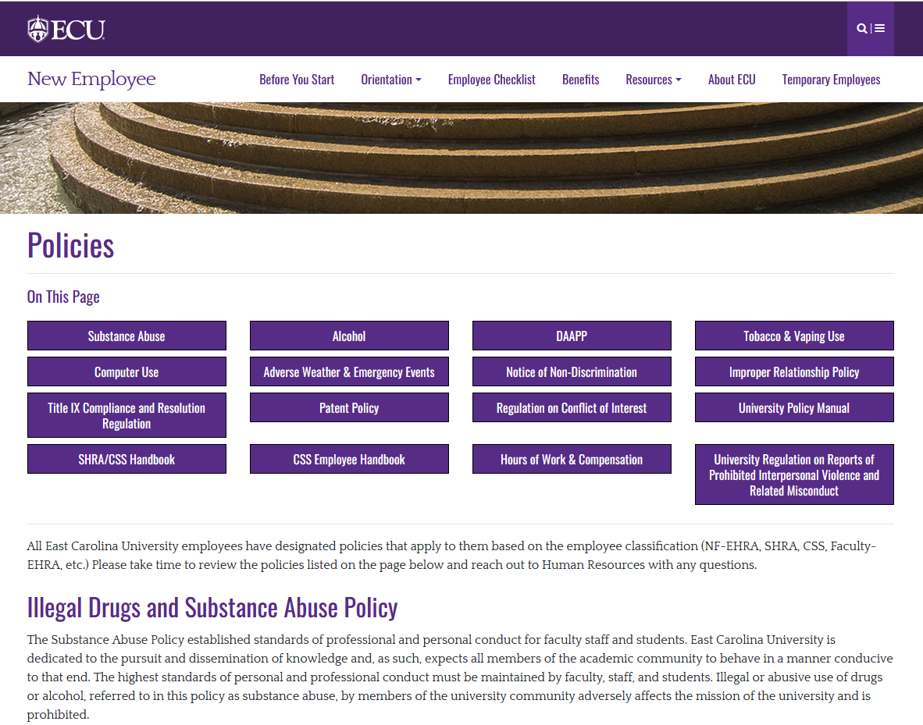
Policies
Log on to https://humanresources.ecu.edu/policies/ to review ECU policies, rules, and regulations.
Before the end of this week, you’ll need to DocuSign your acknowledgement of polices and agreement to abide by ECU policies, rules, and regulations (PRRs).
Notes:
Policies, Voluntary Self Identification

Slide 9
Our Mission To be a national model for student success, public service and regional transformation

Slide 10
Maximize Student Success
"Servire”
To Serve
Serve the Public
Lead
Regional Transformation

Slide 14
ECU Resources
Notes:
Business card

Slide 15
New Employee Checklist
Checklist For Your First:
10 days
30 days
60 days
90 days
End of Probationary Period (if applicable)

Slide 16
Parking & Transportation Services
Notes:
Parking pass and map

Slide 17
Parking & Transportation Services Permit Pricing & Payment Options
Permit Prices
A Zone - $428.00
B Zone - $214.00
Parking Deck - $720
Permit prices begin pro-rating in October
Payment Options
Online: Payroll Deduction (Perm. Employees only) - Post-tax only or Credit Card (Visa, MasterCard or Discover)
In person: Cash or Check in addition to all of the above online options

Slide 18
ECU 1Card
Notes:
FSAB&R flyer

Slide 19
Information Technology and Computing Services (ITCS)
ITCS = Your New Best Friend!
Setting up your computer, access to technology, access to printers, troubleshooting
Download free Microsoft Office Software at pirate365.ecu.edu
You can download Microsoft office on 5 personal devices

Slide 20
Faculty & Staff Meal Plans

Slide 21
Education Benefits for Faculty & Staff
Faculty and Staff Tuition Waiver
SHRA, CSS or EHRA working 30 + hours per week may be eligible
Allows you to take 3 free credit bearing classes per academic year at any UNC System university (according to that institution’s policy)
Textbook Loan Program
Full time Permanent ECU Staff or Faculty and their dependents may be eligible
$250 per semester in textbook rentals for Dowdy Student Stores
https://humanresources.ecu.edu/benefits/educational-assistance/

Slide 22
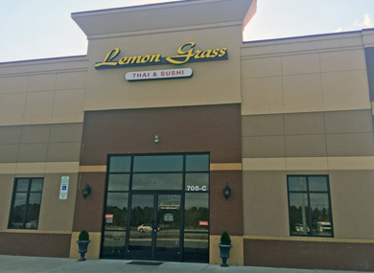
Pirate Perks
You’ve found treasure!
Pirate Perks are discounts and special offers provided by various local businesses to ECU Employees.
To use a Pirate Perk discount, identify yourself as an ECU employee when making a purchase or requesting services by presenting your ECU 1 Card. Please remember, these discounts are made available to ECU employees only.
https://staffsenate.ecu.edu/pirateperks/
East Carolina University and the ECU Staff Senate do not evaluate, endorse or warrant the products or services offered by the Pirate Perks business partners. ECU and the Pirate Perks business partners have the right to discontinue partnership at any time.

Slide 23
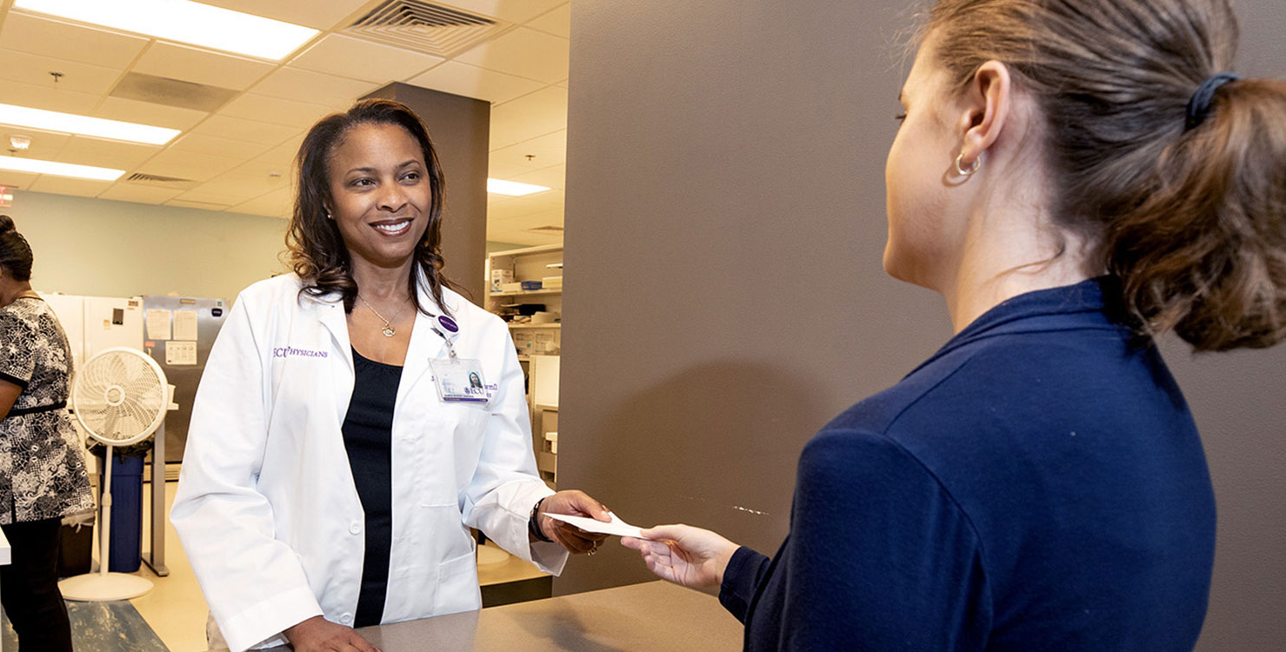
ECU Health & Pharmacy
Rapid Access is a health care service that offers all East Carolina University employees and their immediate families same-day doctor’s appointments at ECU Physicians locations for urgent general-care needs.
Call 252-744-0555 to be seen by a doctor same day!
ECU Physicians Pharmacy Services
Delivers prescriptions to your office location
Provides discounted generics and OTC medications

Slide 24
Campus Recreation & Wellness
New ECU Employees get a free one membership to our Campus Recreation & Wellness centers. It begins whenever you’d like to activate it, and grants you access to all Campus Recreation & Wellness centers as well as the North Lake Recreational Complex.
https://crw.ecu.edu/

Slide 25
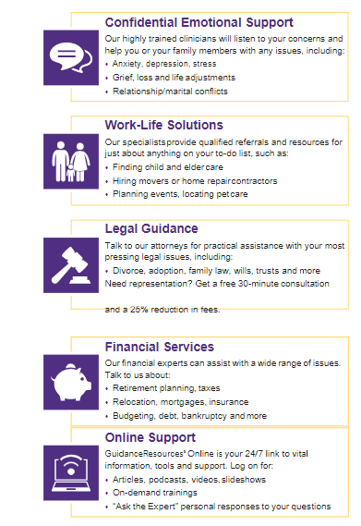
Faculty and Staff Assistance Program
https://humanresources.ecu.edu/employee-relations/faculty-and-staff-assistance-program/

Slide 26
New Employee Website
Notes:
Activate your Pirate ID, Arts, NEO website

Slide 27
To Do This Week
Within 3 Days
Activate Pirate ID
DocuSign Packet
Direct Deposit
Tax Forms
I-9 Documents
Within First Week
OneCard
Update Emergency Contacts
Phase 2 NEO in Cornerstone

Slide 28
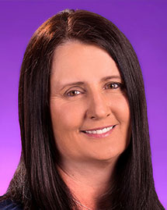
Important Deadlines
Medical – 30 days from date of hire or you will not be covered through ECU. You may sign up again during open enrollment, but that won’t take effect until January of the following year!
Retirement – 60 Days from date of hire; if you don’t select a plan, you’ll be automatically enrolled in TSERS.
Benefits webinar every Thursday at 10:00 AM!
Things to Review Before Thursday!
Printed PowerPoint Presentation
Booklets
Pay special attention to the Decision Guide on page 7-8.
Forms
70/30 & 80/20 Medical Plans and Coverage
Benefits
Overview
Pam Brann Administrative Support Specialist 252-328-9887 brannp18@ecu.edu

Slide 29
Welcome aboard, Pirates!

